Slide 1

SMART TRAFFIC LIGHT CONTROL SYSTEM
GROUP MEMBERS:
Jagmohan Singh 13BCE1056
Marla Akhil Reddy 13BCE1078

Slide 2
Project Idea
Considering the heavy traffic congestion on daily basis sometimes emergency vehicles like ambulance get struck in the congestion which complicates the situation. Normal traffic lights are not able to operate according to the requirement of the emergency vehicles. So, our project basically aims to make them operate keeping the track of the emergency situation.

Slide 3
Design/Algorithm
We are basically operating the traffic light based on the interrupt given by the emergency vehicle .So when it gets the interrupt from the ambulance it turns off all the traffic signal apart from one on which the ambulance is coming.

Slide 4
Proposed- In the project IR transmitter is being used which will transmit the code and the receiver will detect it then microcontroller(Arduino) will get an interrupt and it will stop the normal functioning of the traffic signal and free the path of the ambulance by making the light green.
CCN components to be applied-
Source encoding and Decoding and error detection like checksum and parity Checker.

Slide 5
Design Schematic/Flow Diagram/Block Diagram
Initially the Traffic light will work normally
Ambulance will transmit the IR signal
After receiving the interrupt the arduino will stop the normal functioning of traffic light and clear the way for the ambulance.
When the IR signal is received it will give an interrupt to the arduino

Slide 6
Tools Used (S/w, H/w)
Hardware components-
IR module
Arduino
Breadboard
lEDs, Resistors
Jumper and connecting wires.
Software Used-
Arduino(IDE)
Cost Estimated- Around 250 if we use a general micro controller instead of Arduino.

Slide 7
Work Done
Whenever there is no emergency vehicle like ambulance, the traffic system will work as usual but when vehicle comes it will turn on the green light(according to program) so ambulance will not have to wait.
For making it full proof, source encoding and error detection is done by assigning a specific code to ambulance.

Slide 8
USE CASES
S.No | USE CASE | DESCRIPTION
1 | AMBULANCE SYSTEM | This is deployed to manage the tracking system for each and every ambulance.
2 | TRAFFIC LIGHT CONTROL SYSTEM | It is used to toggle and control the traffic lights.
3 | IR RECIVER/TRANSMITTER SYSTEM | This system helps users to send and receive IR signals to the nearby sub-system telling about their position in traffic.
4 | TRAFFIC CONGESTION CONTROL SYSTEM | This use case plays the vital role in deploying a smooth and perfect traffic system by applying certain algorithms to toggle the traffic lights.

Slide 9
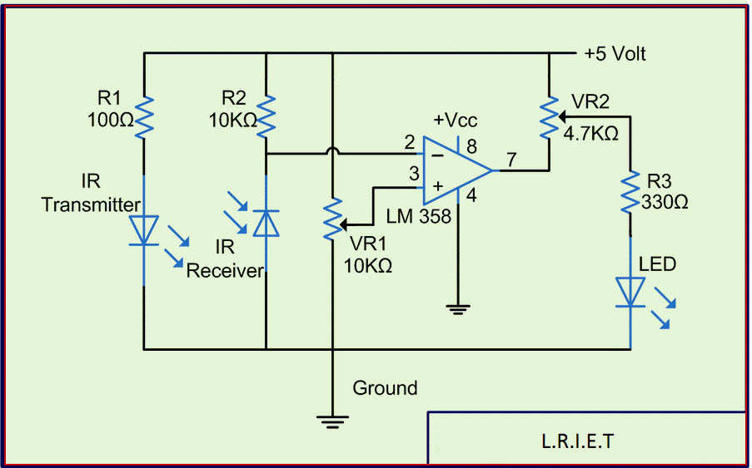
Working Model Diagram

Slide 10
Working Constraints
Traffic congestion needs to happens for deploying this technique.
Only aiming at VIP/Ambulance vehicles.
Works using IR so restricted to particular radius.
Only applicable to Tier-1 city with traffic lights already installed.

Slide 11
Future Improvement
In future this project can be implemented to each and every vehicle irrespective of the priority.
IR can be replaced by GPS modules to increase the effectiveness and span of the connection.
It can be use as a tracking device by the company to seek their employees current positions, like pizza delivery or e-kart suppliers etc.
By using the tracking sensor we can implement our own traffic cloud system to help user to navigate through less clumsy path.

Slide 12
Reference Papers/Web Links
https://www.elprocus.com/infrared-ir-sensor-circuit-and-working/
www.google.com

